Slide 1

CLUSTERING
TEAM – 10
DEEPANRAJ ARUMUGAM MURUGESAN KEERTHIVASAN SURYANARYANAN RANJITKUMAR SETHURAMAN SRUTI SRIRAM

Slide 2
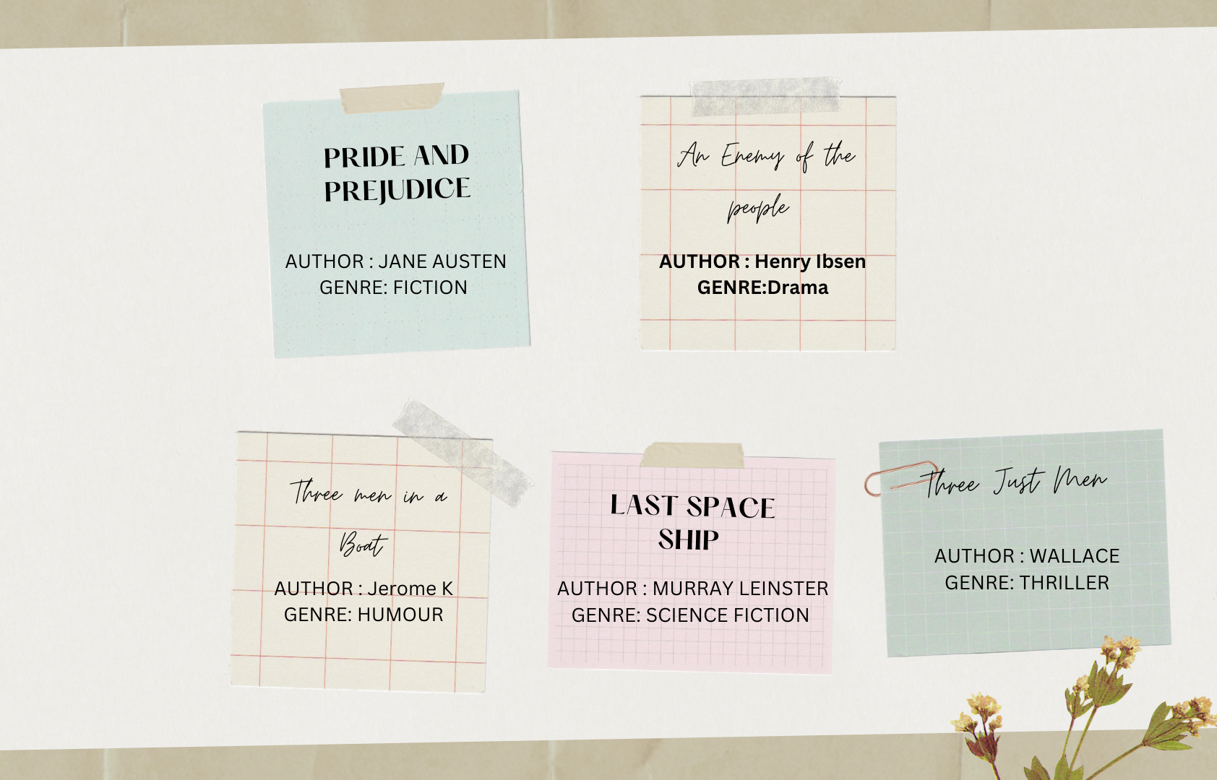
BOOKS

Slide 3
MODELS
The three models that we used are:
K-Means Clustering
EM
Hierarchical Clustering
FEATURE REPRESENTATIONS:
BAG OF WORDS
TF-IDF
LDA

Slide 4
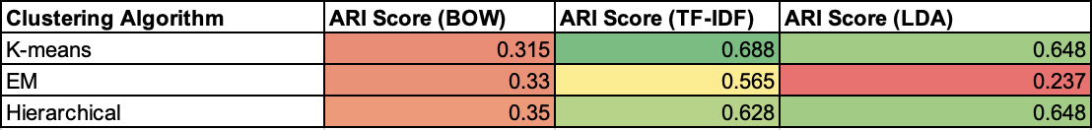
PERFORMANCE METRICS - ARI

Slide 5
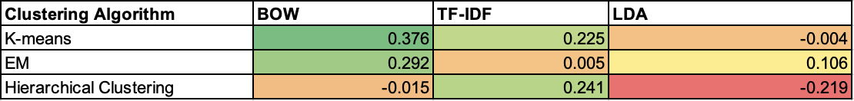
PERFORMANCE METRICS – KAPPA

Slide 6
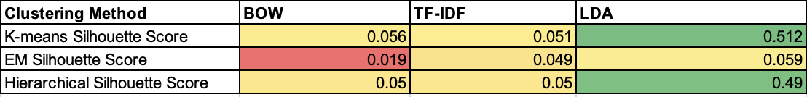
PERFORMANCE METRICS – SILHOUETTE AND COHERENCE
COHERENCE (LDA): 0.481

Slide 7
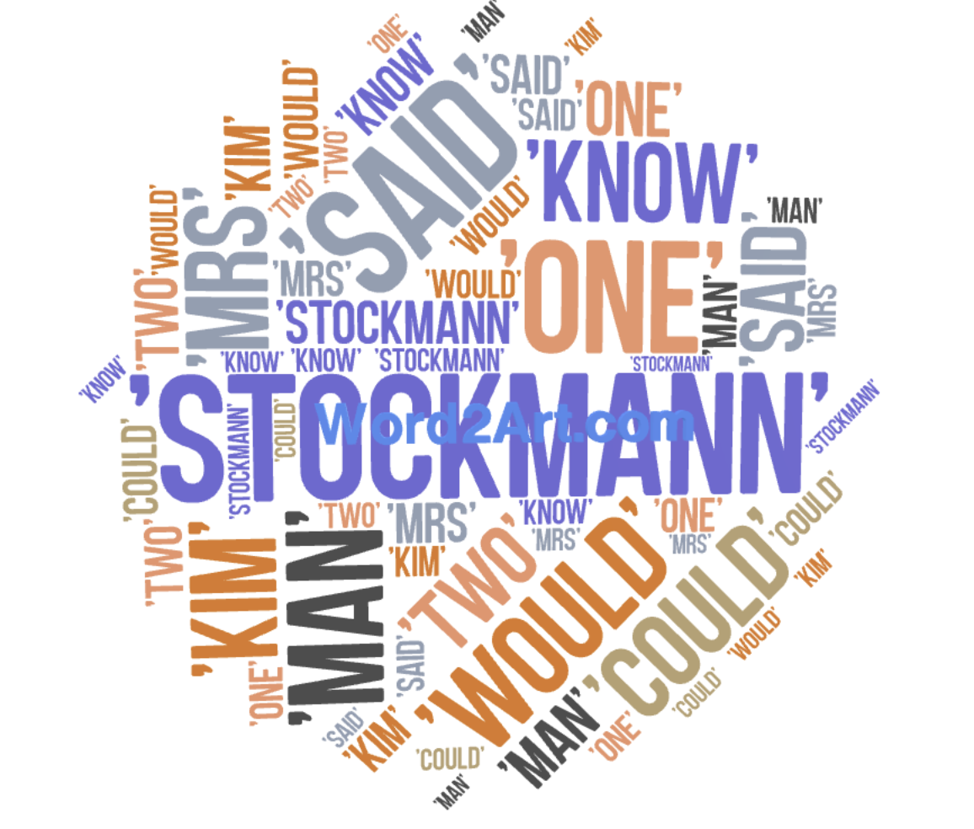
ERROR ANALYSIS
TOP 10 FREQUENT WORDS REASONS:
Frequency
Ambiguity
Context
Part-of-speech
Semantic similarity

Slide 8

Thank you!

